Slide 1
Chapter 5: Availability

Slide 2


Slide 3


Slide 4


Slide 5
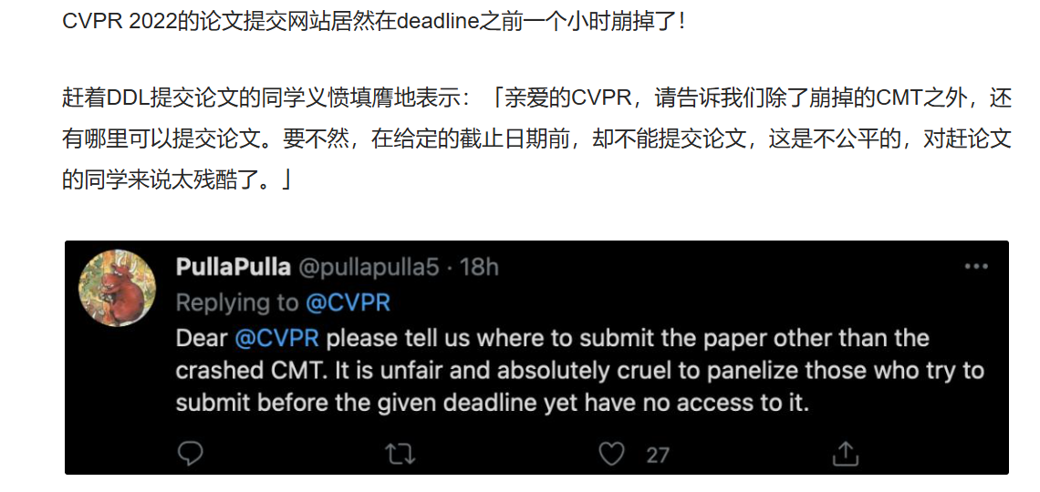

Slide 6
What is Availability?
Availability refers to a property of software that it is there and ready to carry out its task when you need it to be.
Availability refers to the ability of a system to mask or repair faults such that the cumulative service outage period does not exceed a required value over a specified time interval.
Availability is about minimizing service outage time by mitigating faults

Slide 7
Availability
Availability v.s. reliability or dependability
  Availability encompasses what is normally called reliability.
  Availability encompasses other consideration such as service outage due to period maintenance
Availability is closely related to
  security, e..g, denial-of-service
  performance
  …

Slide 8
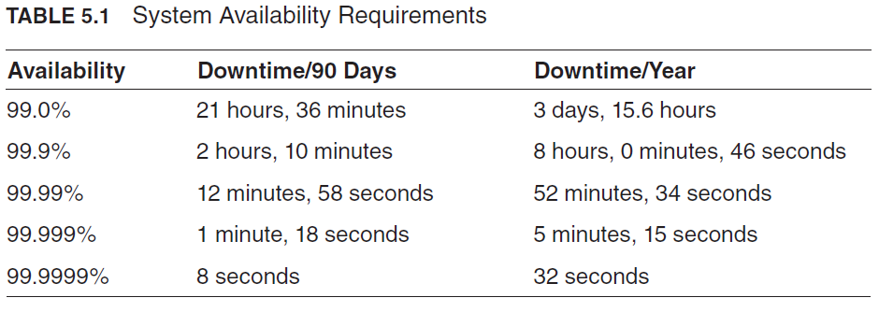
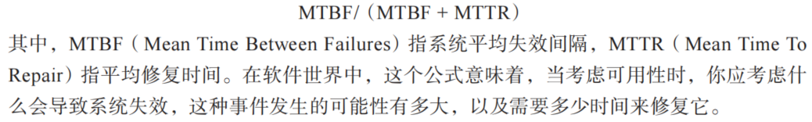

Slide 9
Availability General Scenario
Portion of Scenario | Possible Values
Source | Internal/external: people, hardware, software, physical infrastructure, physical environment
Stimulus | Fault: omission, crash, incorrect timing, incorrect response
Artifact | System’s processors, communication channels, persistent storage, processes
Environment | Normal operation, startup, shutdown, repair mode, degraded operation, overloaded operation
Response | Prevent the fault from becoming a failure Detect the fault: log the fault notify appropriate entities (people or systems) Recover from the fault disable source of events causing the fault be temporarily unavailable while repair is being effected fix or mask the fault/failure or contain the damage it causes operate in a degraded mode while repair is being effected
Response Measure | Time or time interval when the system must be available Availability percentage (e.g. 99.999%) Time to detect the fault Time to repair the fault Time or time interval in which system can be in degraded mode Proportion (e.g., 99%) or rate (e.g., up to 100 per second) of a certain class of faults that the system prevents, or handles without failing

Slide 10
Sample Concrete Availability Scenario
The heartbeat monitor detects that the server is nonresponsive during normal operations. The system informs the operator and continues to operate with no downtime.
  Stimulus: non-responsiveness
  Response: inform the operator
  Response measure: no downtime, or 100 availability percentages
  Environment: normal operation
  Artifact: heartbeat monitor
  Stimulus source: server

Slide 11
Goal of Availability Tactics
Fault (故障) v.s. failure (失效) ?
A failure occurs when the system (unexpectedly) no longer delivers a service consistent with its specification
  this failure is observable by the system’s actors.
A fault (or combination of faults) has the potential to cause a failure.

Slide 12
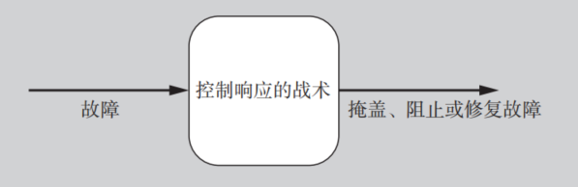
Goal of Availability Tactics
Availability tactics enable a system to endure faults so that services remain compliant with their specifications.
The tactics keep faults from becoming failures or at least bound the effects of the fault and make repair possible.

Slide 13
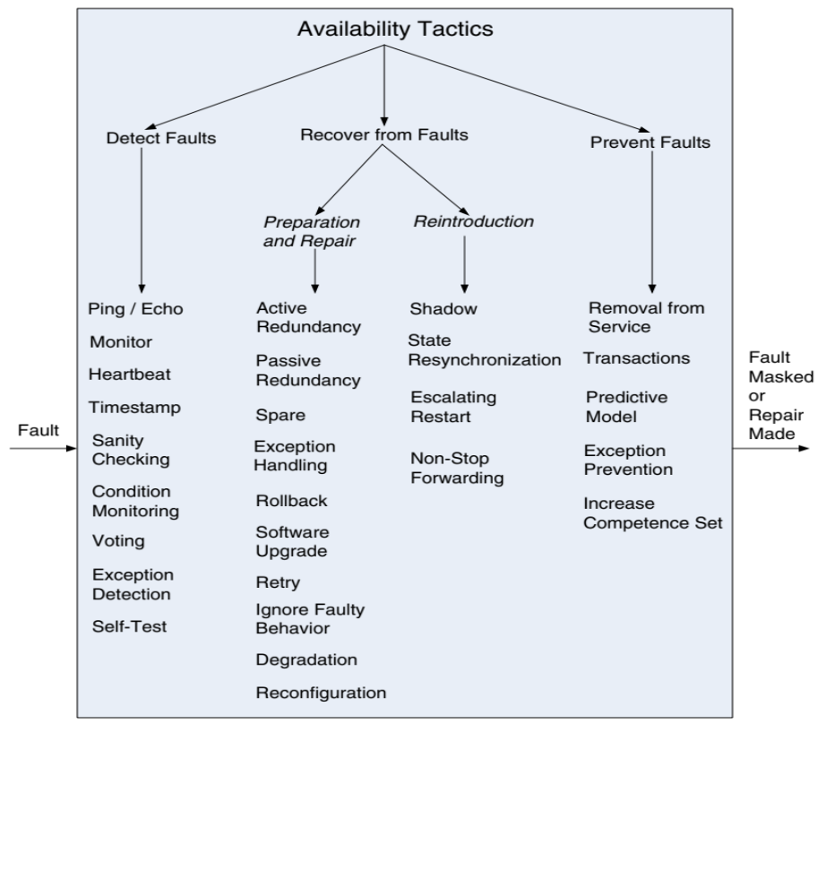
Availability Tactics

Slide 14
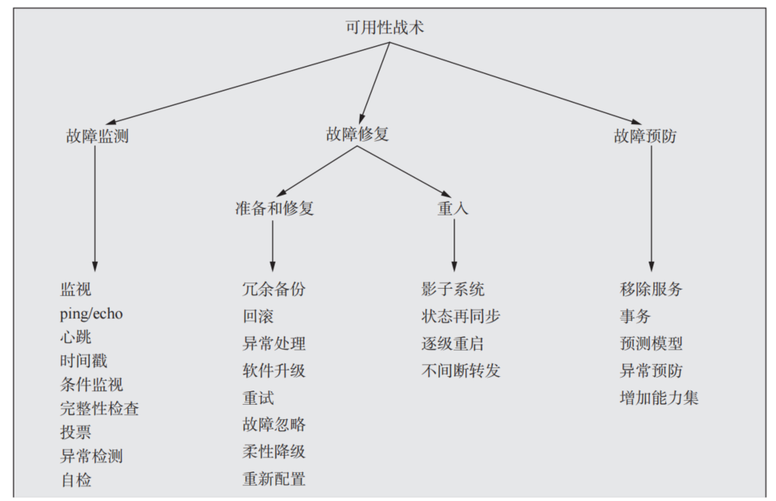
Availability Tactics
教科书 p45-50

Slide 15
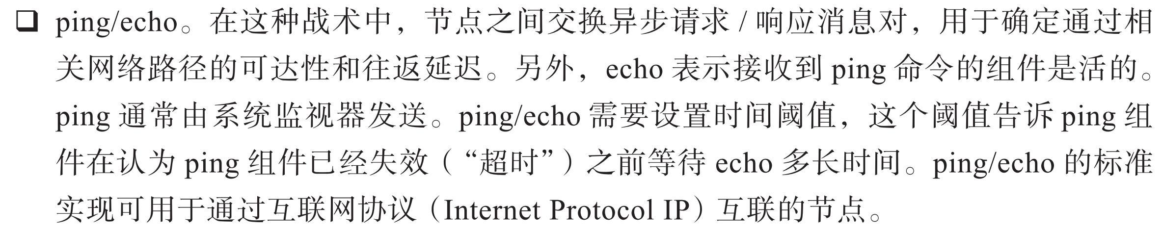
Detect Faults
Ping/echo: used to determine reachability and the round-trip delay through the associated network path.

Slide 16

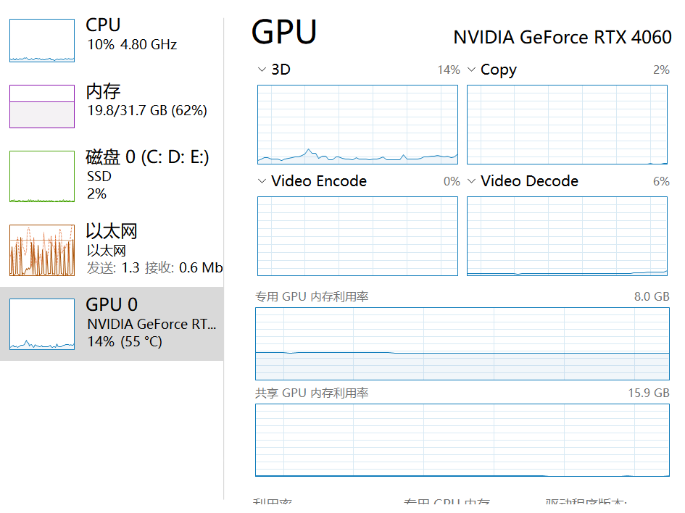
Detect Faults
Monitor: a component used to monitor the state of health of other parts of the system

Slide 17
Detect Faults: Heartbeat
Heartbeat: a periodic message exchange between a system monitor and a process being monitored.
  The process periodically resets the watchdog timer in its monitor,
  Piggybacking the heartbeat messages on to other control messages reduces the overhead
Difference between ping and heartbeat?
  Who initiates the health check?
Notes:
Piggybacking搭载
使用定期重置的计数器或定时器实现的检测机制在专业上也称为看门狗

Slide 18

Detect Faults: Heartbeat
Heartbeat: a periodic message exchange between a system monitor and a process being monitored.
Notes:
Piggybacking搭载
使用定期重置的计数器或定时器实现的检测机制在专业上也称为看门狗

Slide 19

Detect Faults
Timestamp: used to detect incorrect sequences of events, primarily in distributed message-passing systems.

Slide 20

Detect Faults
Condition Monitoring: checking conditions in a process or device, or validating assumptions made during the design.
  For example, checksum in data storage and transmission

Slide 21
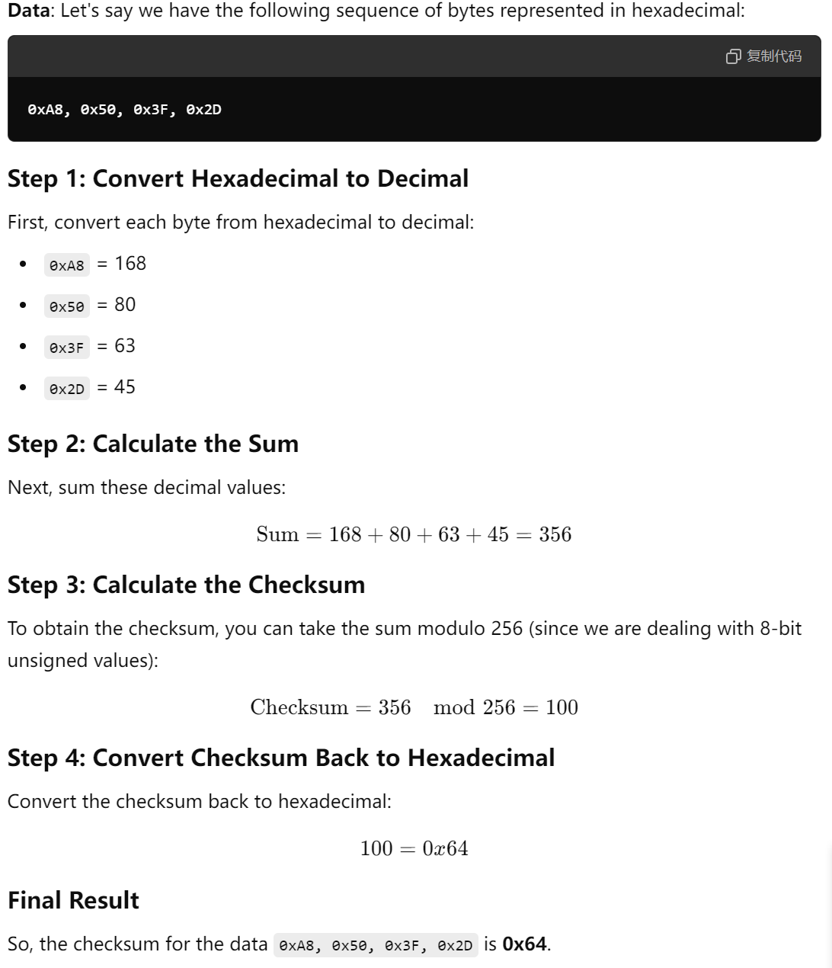
Checksum

Slide 22
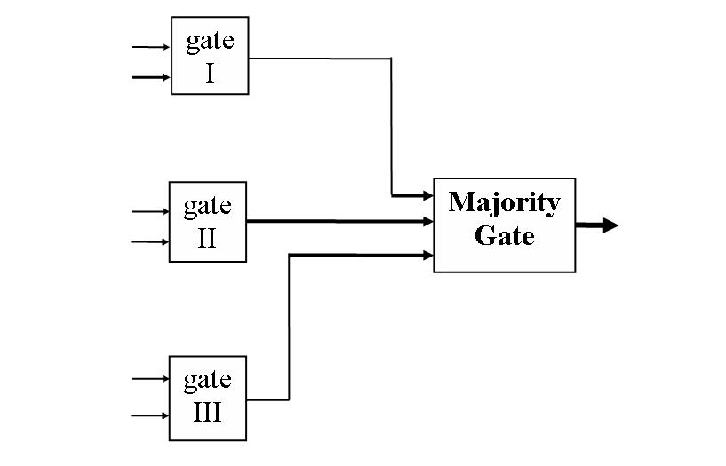
Detect Faults
Voting: the common realization of this tactic is Triple Modular Redundancy (TMR)
Voting component

Slide 23
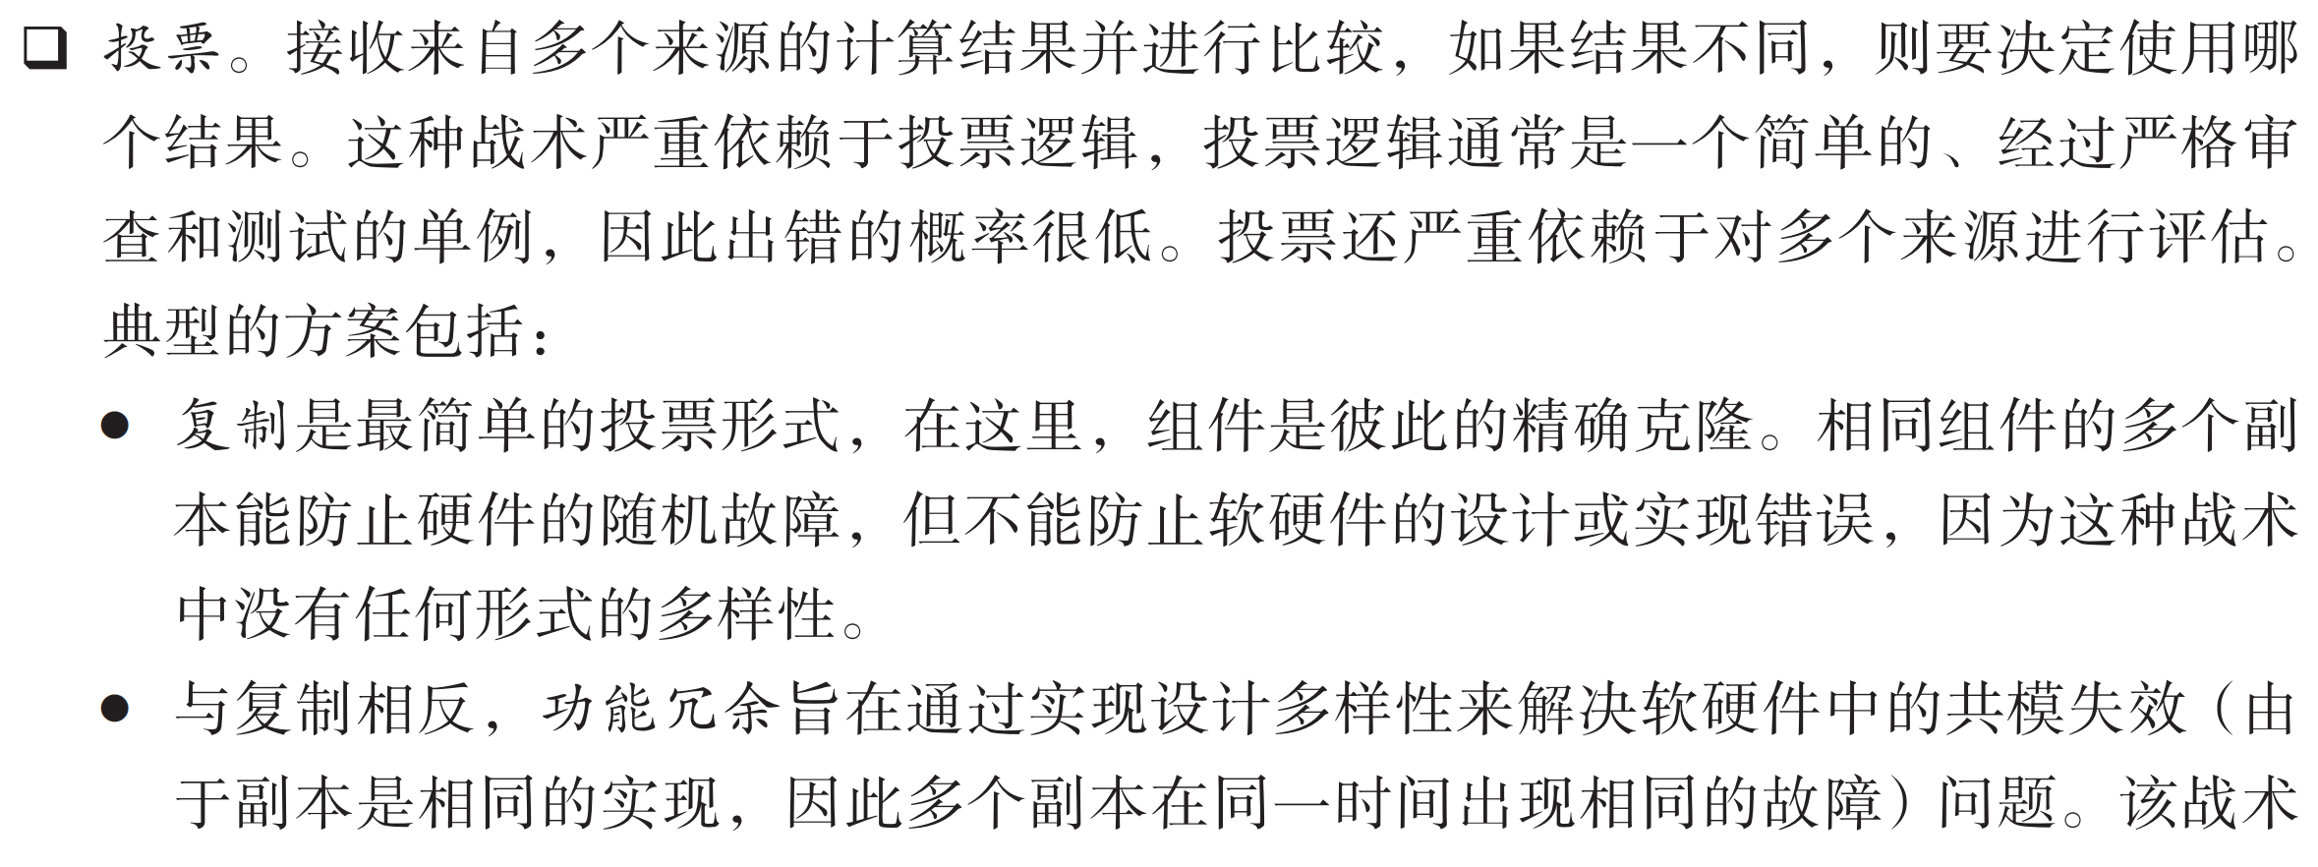
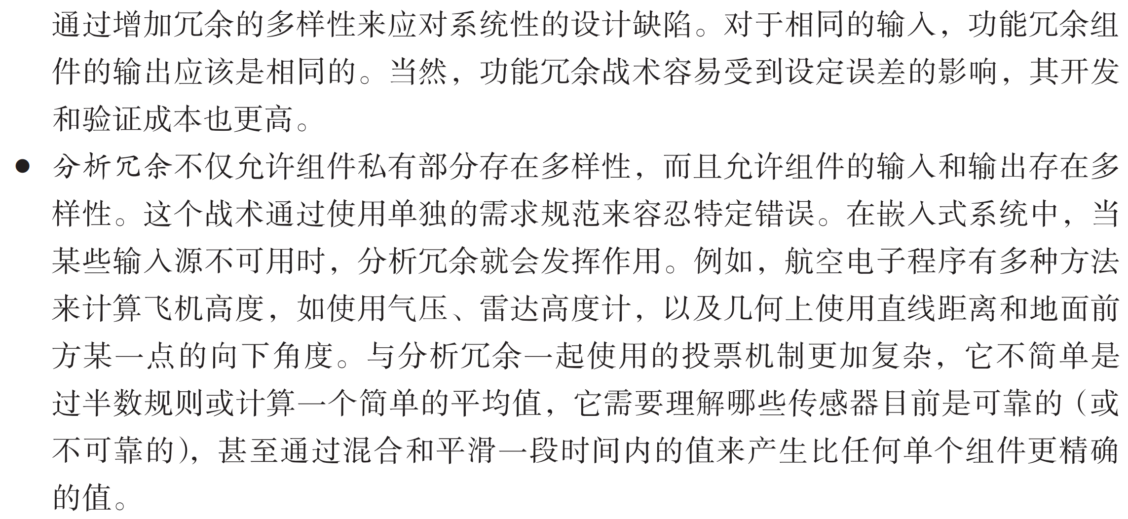
Detect Faults
同一个目标，用相同原理去实现
同一个目标，用不同原理去实现
同一个目标，用不同来源的输入

Slide 24
Recover from Faults
(Preparation & Repair)
Active Redundancy (hot spare): all nodes in a protection group process identical inputs in parallel, allowing redundant spares to maintain synchronous state with the active nodes.
Spare (cold spare): redundant spares of a protection group remain out of service until a fail-over occurs, at which point a power-on-reset procedure is initiated on the redundant spare prior to its being placed in service.

Slide 25
Recover from Faults
(Preparation & Repair)
Passive Redundancy (warm spare): only the active members of the protection group process input traffic;
one of their duties is to provide the redundant spare(s) with periodic state updates.
Notes:
VM

Slide 26

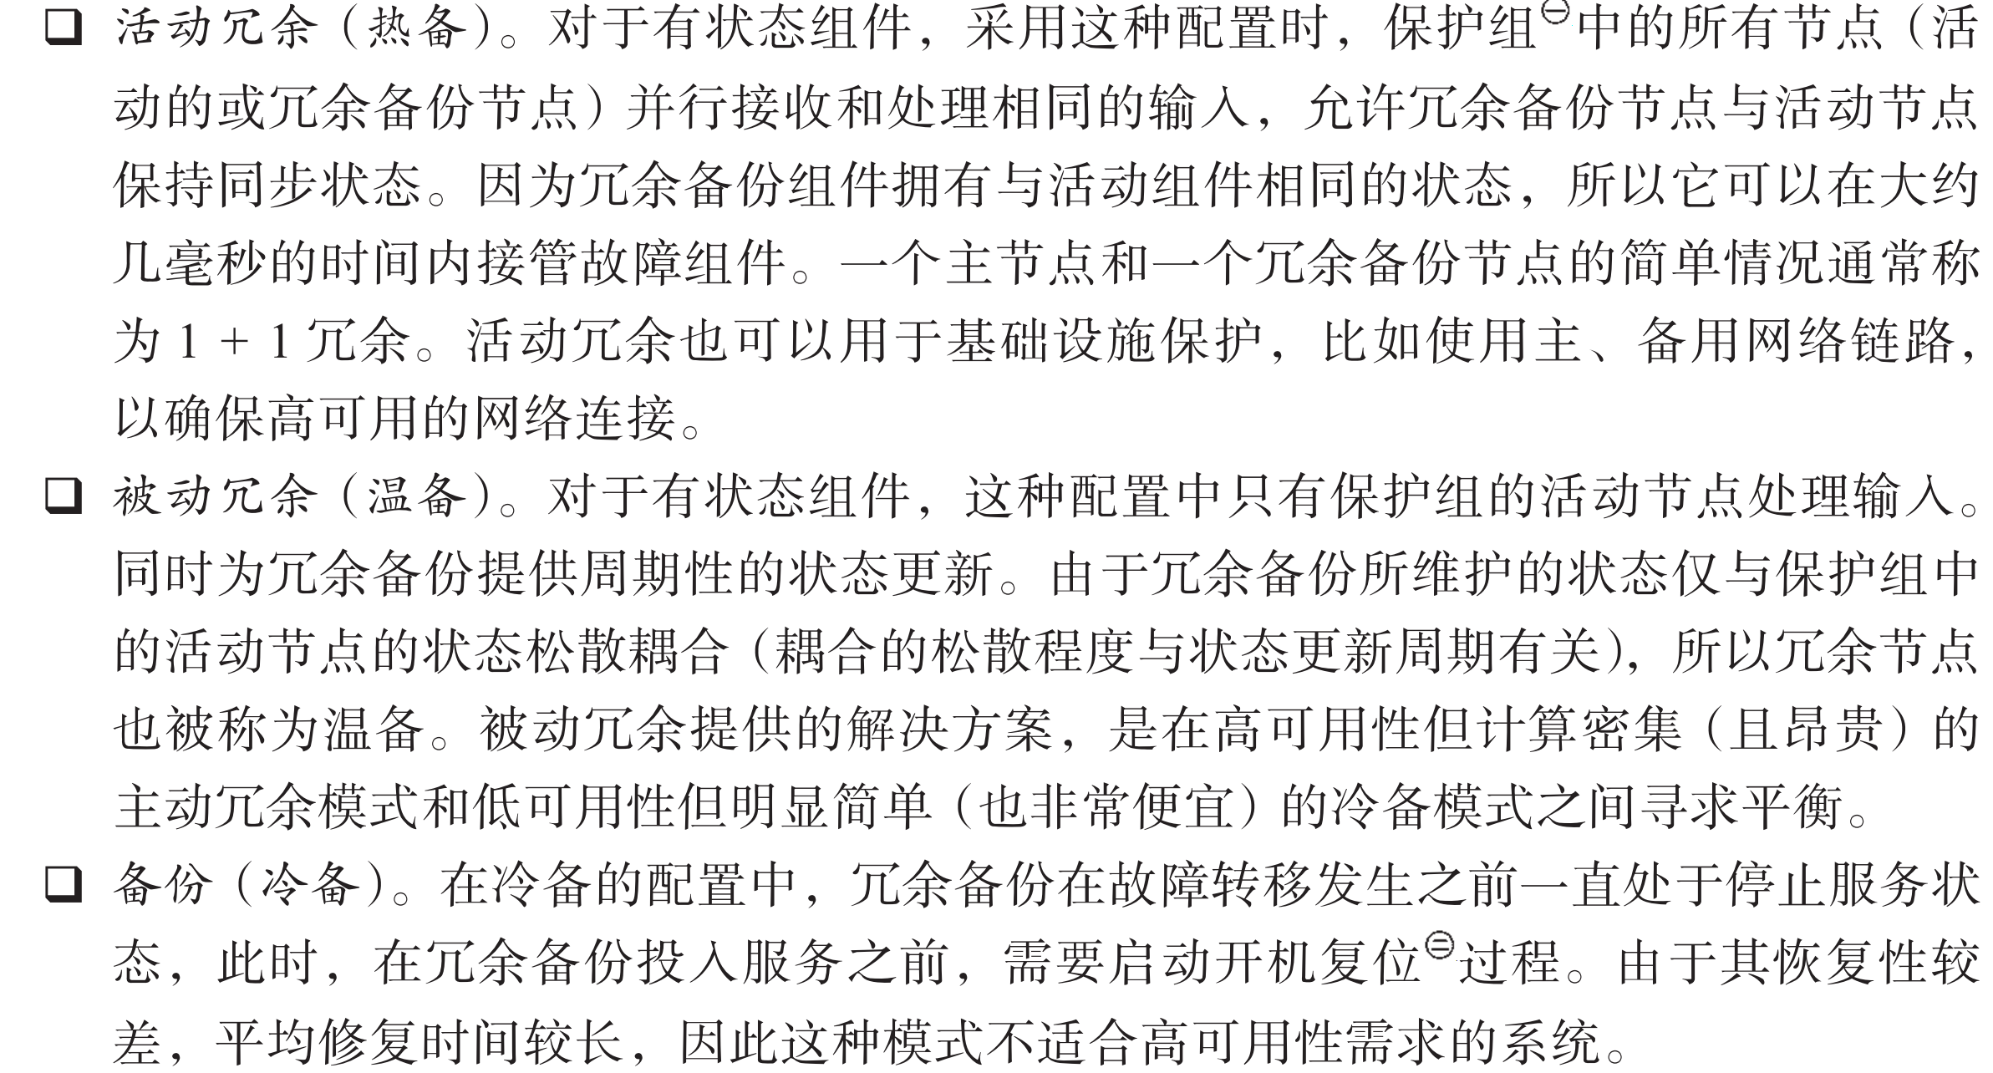
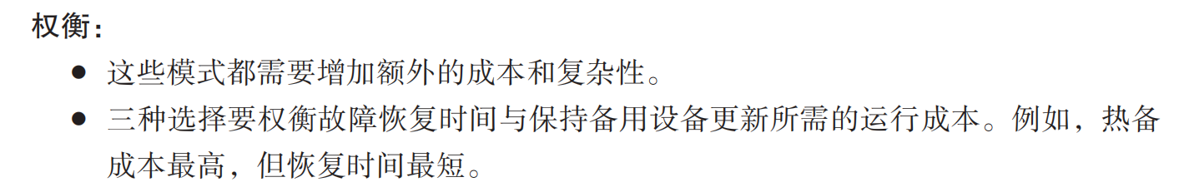
Recover from Faults

Slide 27
Recover from Faults
(Preparation & Repair)
Rollback: revert to a previous known good state, referred to as the “rollback line”.
This tactic is combined with redundancy tactics
After a rollback has occurred, a standby version of the failed component becomes active
Rollback depends on a copy of a previous state (a checkpoint)
Checkpoint can be stored in a fixed location and needs to be updated regularly
For example, when a mobile phone system is upgraded to a new version and some serious bugs or compatibility issues are found, the system can choose to roll back to the previous stable version.

Slide 28

Recover from Faults
(Preparation & Repair)

Slide 29
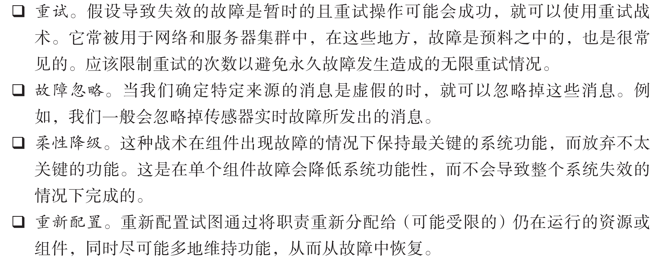
Recover from Faults
(Preparation & Repair)
Retry: where a failure is transient and retrying the operation may lead to success.
  For example, network re-transmission
  There should be a limit on the number of retries that are attempted before a permanent failure is declared.

Slide 30
Recover from Faults
(Preparation & Repair)
Ignore Faulty Behavior: ignoring messages sent from a source when it is determined that those messages are spurious.
  E.g., ignore the messages from a denial of service attacker

Slide 31
Recover from Faults
(Preparation & Repair)
Degradation: maintains the most critical system functions in the presence of component failures, dropping less critical functions.

Slide 32
Recover from Faults
(Preparation & Repair)
Reconfiguration: reassigning responsibilities to the resources left functioning, while maintaining as much functionality as possible.

Slide 33
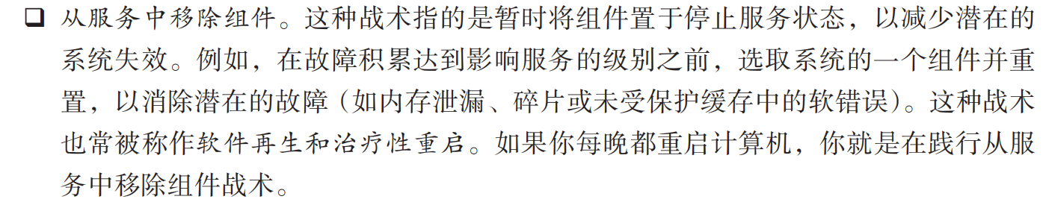
Prevent Faults
Removal From Service: temporarily placing a system component in an out-of-service state for the purpose of mitigating potential system failures
  Temporarily remove the server with degraded performance from the service queue
  Restart your computer

Slide 34
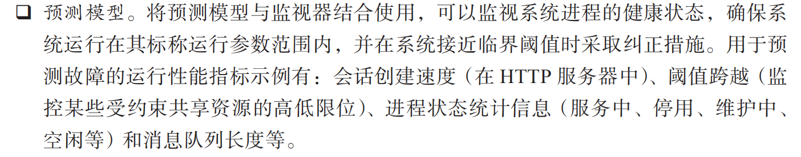
Prevent Faults
Predictive Model: take corrective action when conditions are detected that are predictive of likely future faults.
  e.g. Temperature is too high…

Slide 35
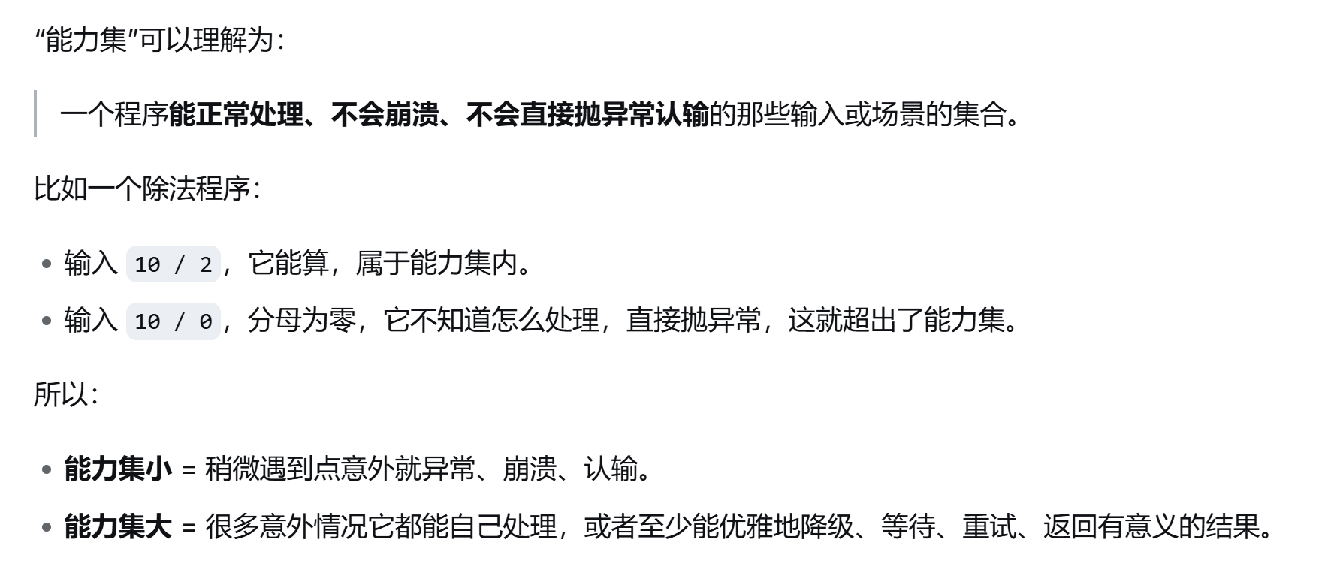
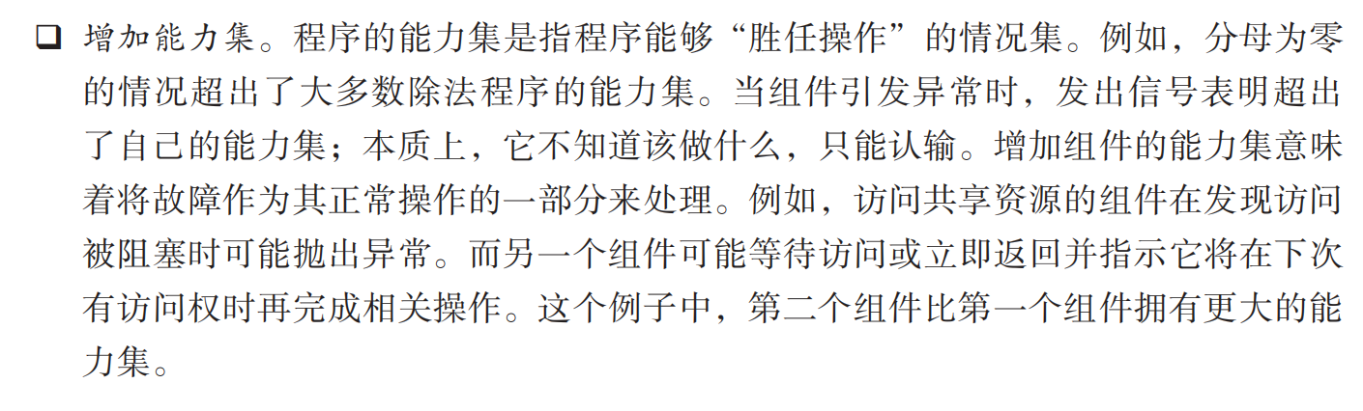
Prevent Faults
Increase Competence Set: designing a component to handle more cases—faults—as part of its normal operation

Slide 36
Prevent Faults
Transactions: “two-phase commit” (a.k.a. 2PC) protocol. This tactic prevents race conditions caused by two processes attempting to update the same data item.
  If you transfer money from account A to account B, the transaction steps include:
    Deduct money from account A
    Deposit the corresponding amount of money into account B
  Through the transaction mechanism, these two steps will either succeed or fail, avoiding the situation where the deduction succeeds but the credit fails

Slide 37
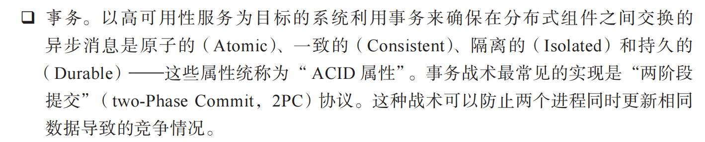
Prevent Faults

Slide 38
Summary
Availability refers to the ability of the system to be available for use when a fault occurs.
The fault must be recognized (or prevented) and then the system must respond.
The response will depend on the criticality of the application and the type of fault
  can range from “ignore it” to “keep on going as if it didn’t occur.”

Slide 39
Summary
Tactics for availability are categorized into detect faults, recover from faults and prevent faults.
Detection tactics depend on detecting signs of life from various components.
Recovery tactics are retrying an operation or maintaining redundant data or computations.
Prevention tactics depend on removing elements from service or limiting the scope of faults.

